Slide 1
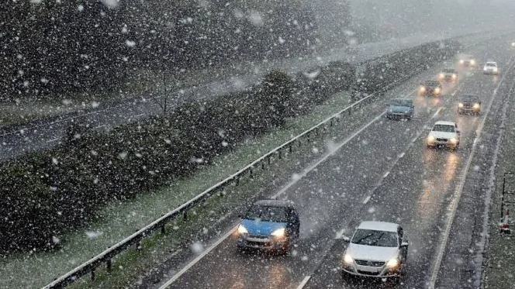
IMPACT OF ADVERSE WEATHER CONDITIONS ON TRAFFIC ACCIDENTS IN THE UNITED STATES: A 2017-2022 ANALYSIS
Submitted by
Sai Manigopal Reddy Kanumathireddy, Venkata Aditya Kantipudi

Slide 2
INTRODUCTION
Importance:
These questions are crucial for identifying safety measures to reduce weather-related accidents. Bad weather impairs visibility and road traction, increasing accident risks. Understanding how factors like light conditions and driver behavior interact with weather aids in developing effective safety policies and raising public awareness.
How do adverse weather conditions, such as rain, snow, and fog, impact the frequency and severity of traffic accidents across the USA from 2017 to 2022?
Research Questions:
What additional factors, such as driver behavior, road conditions, and light conditions interact with adverse weather to influence accident outcomes?

Slide 3
LITERATURE REVIEW
(Xing, 2019) found non-linear impacts of factors like temperature on accident rates.
(Becker, 2022) demonstrated that rain, snow, and glare affect crash types differently.
(Pińskwar, 2024) highlighted how extreme weather increases driver cognitive load.
(Tobin, 2022) emphasized the role of winter conditions like snow and low visibility in fatal crashes.

Slide 4
DATA DESCRIPTION
Key Variables:
Weather condition, Fatalities, Surface Condition, Injury Severity, Drinking Status, Light Condition, and other weather variables like Temperature, Dewpoint, Humidity, Precipitation etc.
Fatality Analysis Reporting System (FARS) 2017-2022.
Data Sources:
Weather data from Meteostat Python library.
Dataset contains approximately 50,000 rows.

Slide 5
DATA CLEANING
1. Data Consolidation: Loaded all the relevant files and merged them into a single file and and dropped irrelevant columns (e.g., road ownership, work zone, school bus) from FARS accident file.
2. Data Filtering: Filtered the dataset to only include adverse weather conditions and excluded rows with clear or unknown weather conditions.
3. Column Standardization: Converted all the columns to lowercase and properly named all the columns.
4. Field Cleanup: Cleaned fields like countyname to remove special characters such as parentheses ‘(’ and ‘)’.
5. Outlier Handling: Identified and replaced outliers in hour and minute columns with NA values. Detected outliers in latitude and longitude columns and corrected coordinates using statename and countyname with the tidygeocoder package.
6. Dataset Integration: Combined FARS accident data with Meteostat weather data by matching location (latitude, longitude) and time details (hour, minute, and date) to create a comprehensive dataset.

Slide 6
DATA VISUALIZATIONS

Slide 7
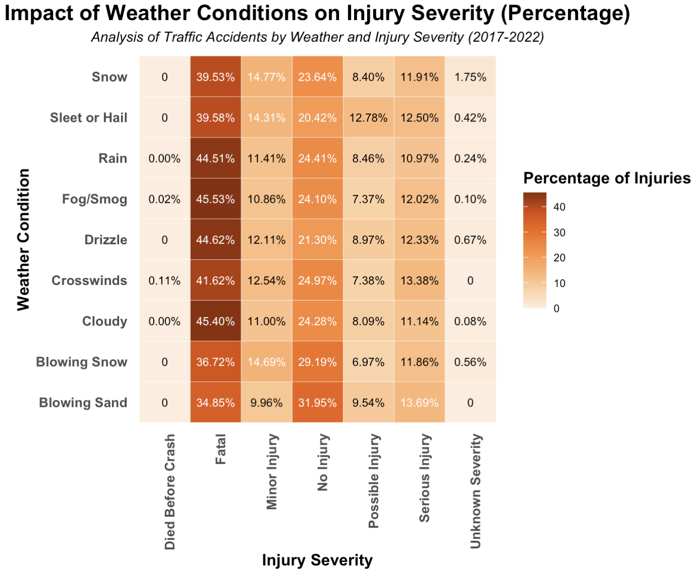
Impact Of Weather Conditions On Injury Severity
Rain, Fog/Smog, and Cloudy conditions exhibit the highest percentages of fatal injuries at 44.51%, 45.53%, and 45.40%, respectively, indicating the dangers of reduced visibility.
These weather types underscore the risks of adverse driving conditions, especially in situations with impaired visibility.

Slide 8
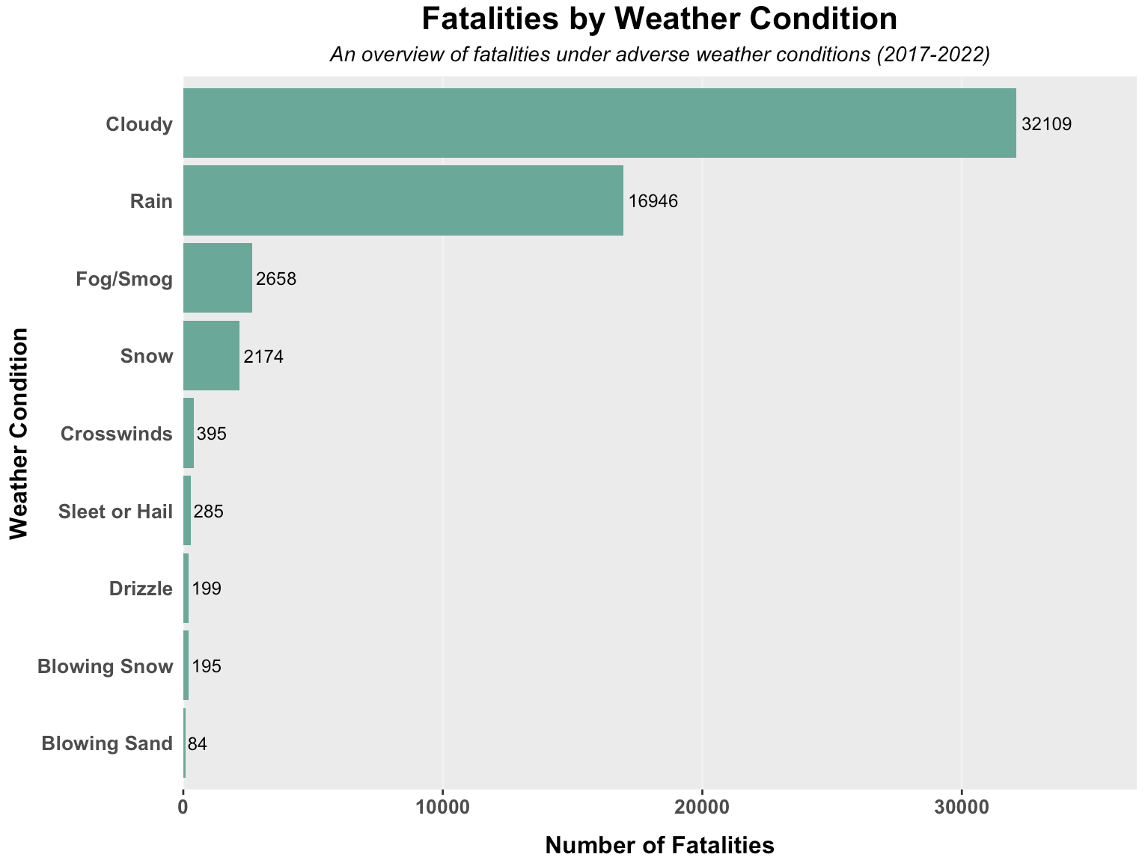
Impact Of Weather Conditions On Traffic Fatalities
The horizontal bar chart shows that Cloudy conditions recorded the highest fatalities (32,109), followed by Rain (16,946), likely due to reduced visibility or driver complacency.
It also highlights that Blowing Sand and Blowing Snow had the lowest fatalities, possibly due to their rarity or increased caution during such events.

Slide 9
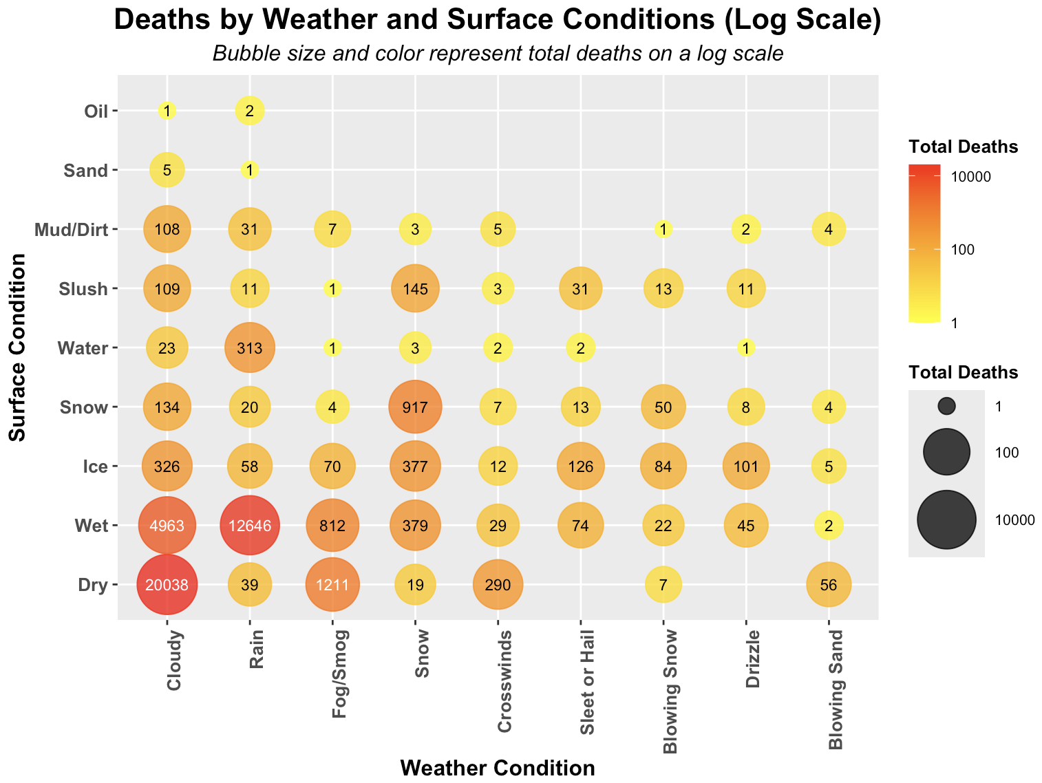
Impact of Weather and Surface Conditions on Fatalities
Dry surfaces under cloudy weather recorded the highest deaths (20,038), followed by wet surfaces during rainy weather (12,646).
Icy and slushy surfaces showed lower fatality counts, possibly due to more cautious driving, while the bubble size and log scale effectively highlight high-fatality conditions for better comparison.

Slide 10
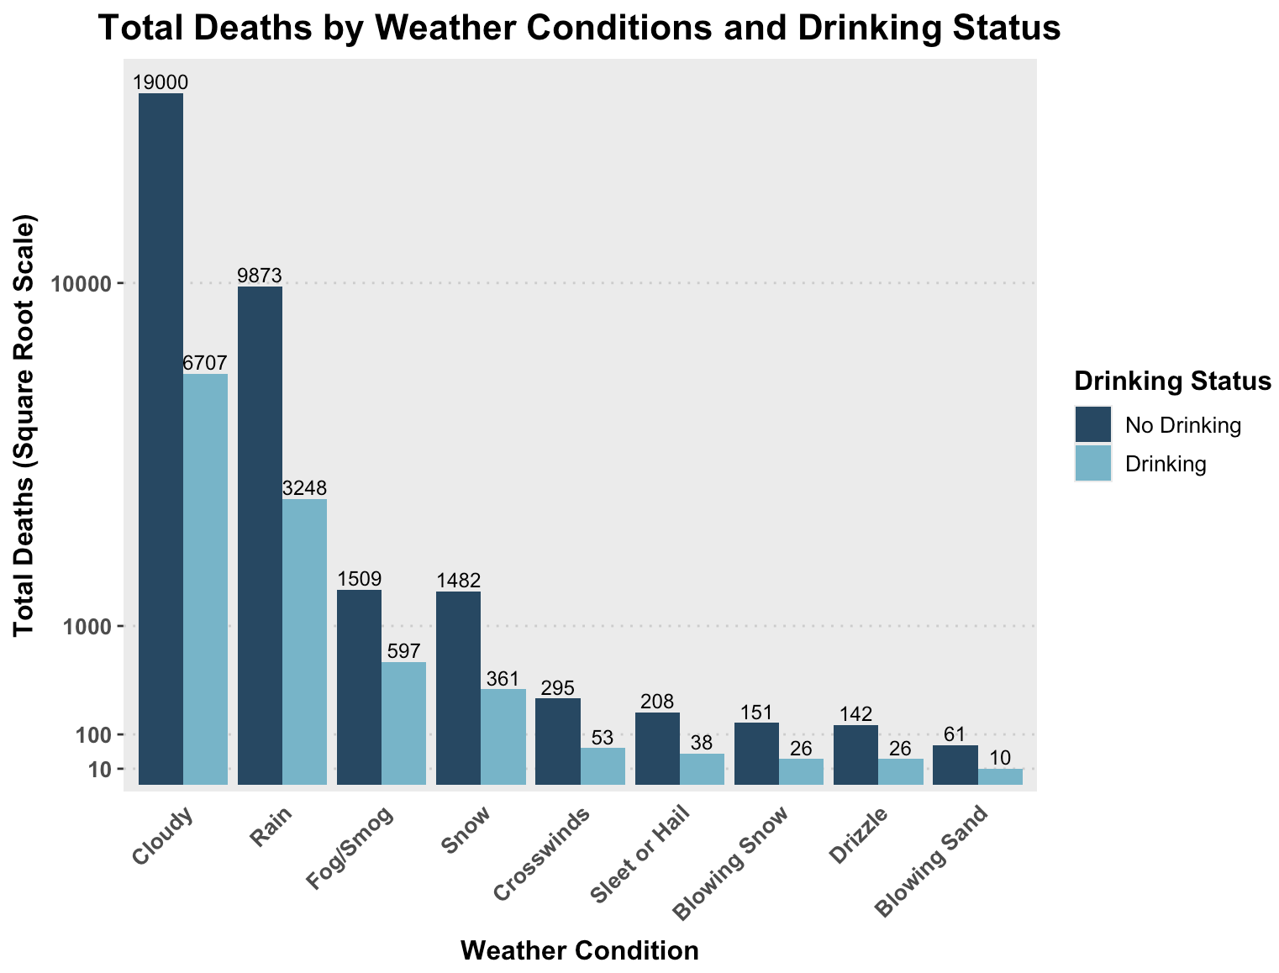
Fatalities by Weather Conditions and Driver Sobriety
Cloudy weather records the highest fatalities, with 19,000 under non-drinking and 6,707 under drinking status, followed by Rain and Fog/Smog.
Non-drinking fatalities consistently outnumber drinking-related fatalities across all weather conditions, emphasizing the critical role of driver sobriety in fatal accidents.

Slide 11
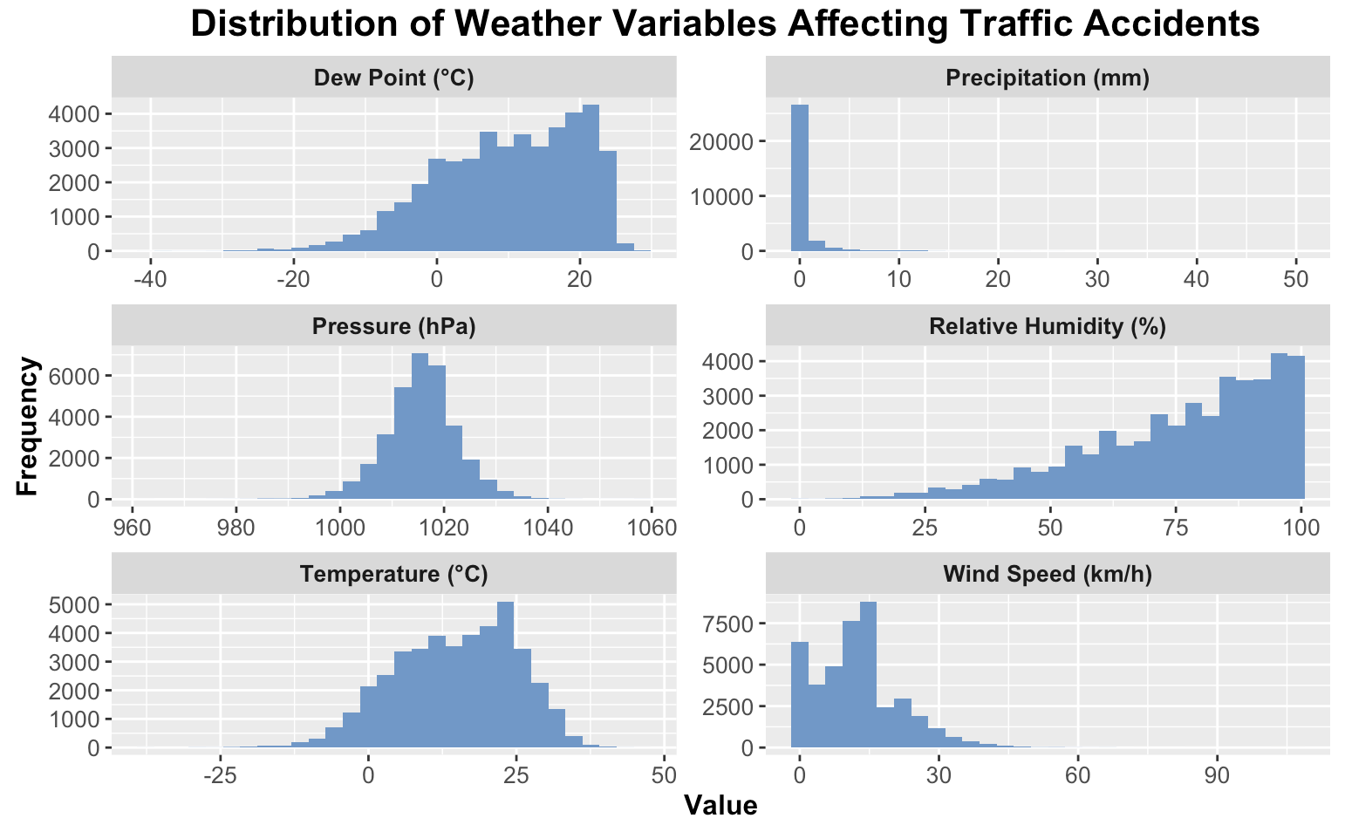
Weather Variable Distributions and Their Impact on Accidents
Dew Point and Temperature show near-normal distributions, while Precipitation is skewed toward low values, highlighting its rarity during traffic accidents.
Pressure is concentrated between 1000 and 1025 hPa, reflecting stable conditions, while Relative Humidity and Wind Speed distributions suggest that high humidity and low wind speeds are common during accidents.

Slide 12
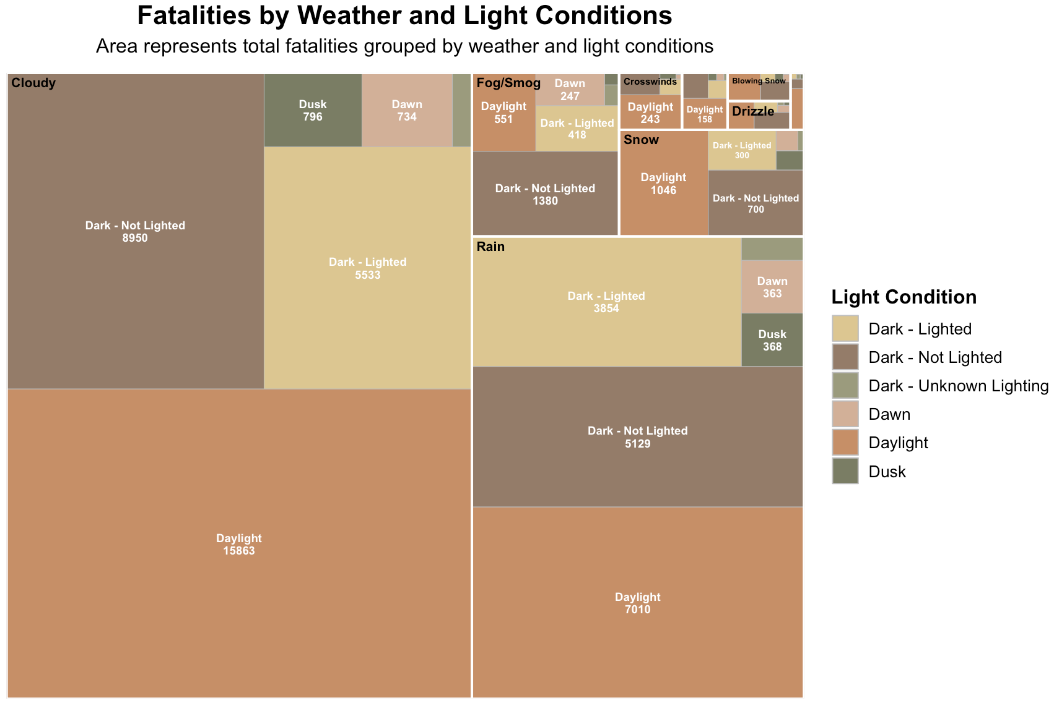
Fatalities Across Weather and Light Conditions
Daylight conditions consistently account for the most fatalities across weather types, particularly under Cloudy and Rain conditions, highlighting their frequent occurrence during accidents.
Poorly lit conditions, such as Dark - Not Lighted, significantly contribute to fatalities, emphasizing the critical role of visibility in preventing accidents.

Slide 13
CONCLUSIONS
Practical Findings Adverse weather like fog, rain, and cloudy conditions significantly increases traffic fatalities due to reduced visibility and traction, with dry and wet surfaces being the most hazardous. Poor lighting, especially "Dark - Not Lighted" conditions, exacerbates risks, and non-drinking driver fatalities consistently outnumber those involving drinking.
Design Weaknesses The study excludes non-fatal accidents and dynamic weather changes, limiting comprehensive insights. Key variables like traffic density and road infrastructure remain unexamined, and visualizations could benefit from interactivity and temporal elements. Future research should adopt a multivariate, time-based approach for actionable safety insights.

Slide 14

Q&A

Slide 15

THANK YOU

